Slide 1
ELHT Integrated Care Update
to Pendle Health and Social Care Scrutiny Panel
October 2017

Slide 2
Home First
‘Home First’ has been operational from March 2017 and is now mobilising and expanding to cover Pennine Lancashire:
We believe that if someone is admitted to hospital from their own home they should have the opportunity to see that home again.
We want to reduce the length of time older people spend (unnecessarily) in hospital to prevent further deterioration in their physical functioning and well-being whilst their needs are being assessed and their after-care plan is developed.
We would like to assess in a more appropriate environment to ensure that ongoing plans are as realistic and tailored to true patient need as possible.

Slide 3
Home First

Slide 4

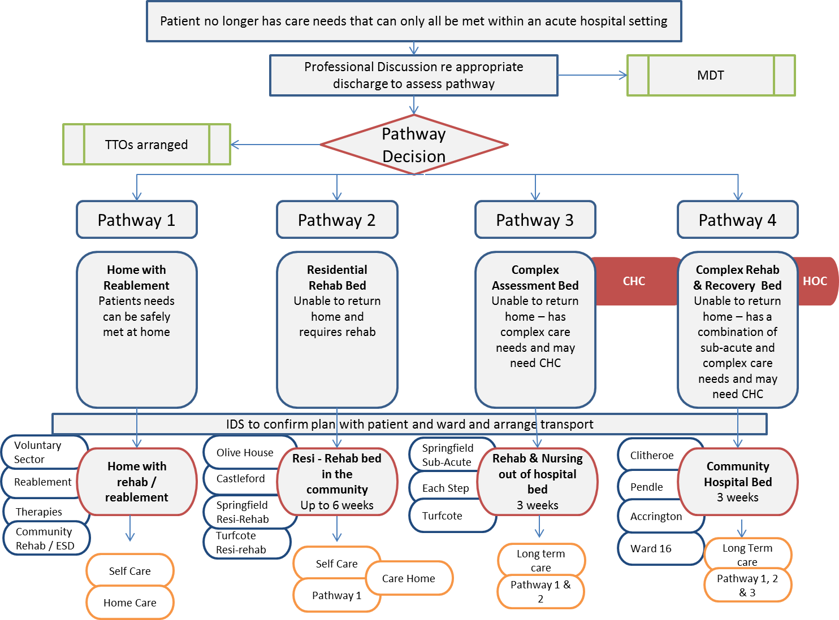


Discharge to Assess
Partners from across the Health and Social care economy have agreed a series of discharge to assess pathways which will be tested throughout the Winter period.
These pathways are supported by testing a new relationship with the care sector to provide the physical capacity and core staffing with in-reach from community nursing and therapy teams to support.
Flow into and out of the beds is managed by the Intermediate Care Allocation Teams for the two local authority areas.

Slide 5
Integrated Neighbourhood Teams
The Integrated Neighbourhood Teams (INTs) service is now available across all localities in East Lancashire, including Pendle. The case management of patients at risk of admission or re-admission has been very well received by all partners, patients and their families. Please see patient story overleaf.
The greatest numbers of referrals to the service are for frail elderly patients (71-85 age range) and exacerbations of long term conditions. Many of the patients have multiple health and social care issues for resolution and benefit greatly from the multi-professional support. Consultants are linking into case management meetings in some neighbourhoods which has improved links with Primary Care.

Slide 6


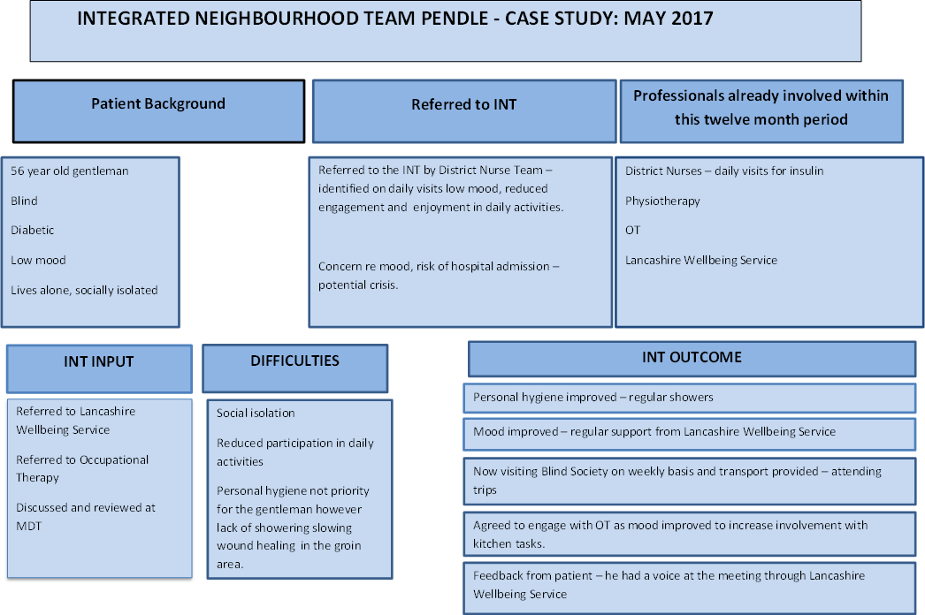
INTs - Patient Story

Slide 7
East Lancs Intensive Home Support Service (IHSS)
Average caseload of 90 patients per day - stay on the caseload for 7 days
Managed over 24 hours with the support of Community Night Nursing Service
Total number of patients referred in the last 12 months across IHSS is 6456 (admissions avoided from Hospital).
Two hour response time from referral
Integrated response from Therapists, Nursing and Social Workers via ICAT
Care packages commenced
Trusted assessment - generates home visits and Assessment from
Advanced Practitioners who can prescribe.

Slide 8
COPD Pathway Development
An IHSS night handover pathway has been implemented which enables safe handover of patient information in order to provide 24 hour care provision and continuation of service.
IHSS provided training for all the night team regarding Long Term Condition management especially around COPD.
Weekly MDT with IHSS and specialist respiratory service taking place.

Slide 9
Front Door Team
The front door team support ED, AMU A & B, UCC and wards.
Between January 2016 and August 2017 the front door team:
  Assessed 6018 patients
  Avoided 2081 admissions from ED
  Discharged 2253 patients from AMU A & B
  Discharged 896 patients from ELHT wards
89% of the patients seen by the front door team are aged 61+. Many of which are likely to be ‘frail elderly.’

Slide 10
Front Door Team - continued
Top clinical presentations to front door team:

Slide 11
Falls Response Service
Jan 2016 – May 2017
So far…
1864 CALLS
2983 ERISS referrals
30 to hospital post FRS within a week
444.5 days on the road
80% remained at home
Conservative Financial Savings
£1,2M
78% mobile in under 30 mins v 240 mins NWAS
The Falls Response Car links into the IHSS and ICAT service with an Occupational Therapist working with a Paramedic to prevent a conveyance to ED by putting an urgent care package in place to support frail elderly patients in their home with an on-going assessment. The next quarterly report is due soon.
Response car is Pennine wide.

Slide 12
65+ Age Band Population
On average the 65+ population is increasing by 140 patients per month across Pennine Lancashire

Slide 13
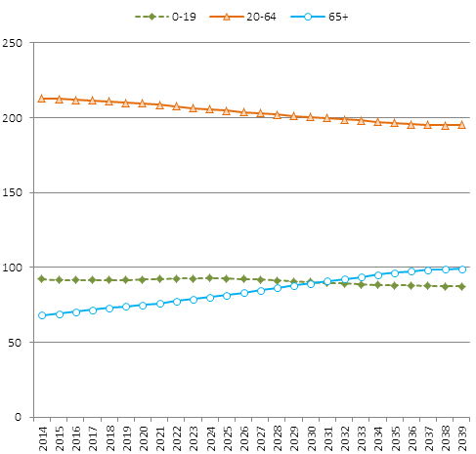
Long term population estimates
This data demonstrates the longer term population forecast for East Lancashire, further confirming that the 65+ population is growing significantly and will continue to do so.

Slide 14
Home First data
Activity and Outcomes: Home First Summary Dash Board Extract
 |  | 2016 | 2017
 |  | March | April | May | June | July | August | TOTAL
Initial Visits and Social Care Usage | Total number of people brought home for initial assessment | 11 | 23 | 36 | 31 | 32 | 36 | 169
 | Total number of patient who stayed at home following initial assessment | 11 | 23 | 36 | 31 | 32 | 36 | 169
 | Number of people who had an initial recommendation of social care | 9 | 16 | 21 | 20 | 19 | 24 | 109
 | Average number of social care hours (for those who needed it) in 5 day period | 8 | 6.88 | 9.52 | 11.47 | 6.35 | 13.92 | 9.36
Reviewing activity and outcomes | Number of people who did not receive an initial social care service but required one upon 3 day review | 0 | 1 | 3 | 3 | 1 | 1 | 1.50
 | Total Number of people who transferred on to reablement | 7 | 12 | 20 | 17 | 15 | 18 | 89
 | Average daily visits commissioned per reablement package | 2 | 2 | 2 | 2 | 2 | 2 | 2
 | Number of people who received more daily visits on reablement than they did for their home first package (not inc those who did not receive an initial social care service) | 3 | 2 | 2 | 3 | 0 | 4 | 14
 | Number of people who received fewer daily visits on reablemenet than they did for their home first package | 3 | 3 | 9 | 4 | 1 | 2 | 22
 | Total Number of people who were readmitted to hospital during their 5 day home first journey | 0 | 1 | 0 | 1 | 1 | 3 | 6
 | Total Number of people who transferred to a community bed (I.e. commissioned residential rehab/recovery) during their 5 day home first journey | 0 | 0 | 1 | 1 | 0 | 2 | 4
 | Total Number of people who received a care package (rather than reablement) at home at the end of their home first journey | 0 | 0 | 1 | 1 | 1 | 0 | 3
 | Total number of people who had their existing care package restarted with no additional visits | 0 | 0 | 0 | 0 | 3 | 0 | 3
 | Total number of new telecare commissions | 0 | 0 | 4 | 4 | 7 | 2 | 17
Voluntary Sector | Age UK Hospital Aftercare Referrals Total Number | 0 | 0 | 0 | 0 | 1 | 0 | 1
 | Age UK Integrated Care Programme Referrals Total Number | 0 | 0 | 0 | 2 | 1 | 1 | 4
Community Health Referrals | Intensive Home Support : Nursing Services | 0 | 0 | 0 | 1 | 1 | 0 | 2
 | Intensive Home Support : Therapy / Rapid Assessment Team | 0 | 0 | 0 | 1 | 2 | 2 | 5
 | Medicines Management | 0 | 0 | 0 | 1 | 3 | 3 | 7
 | Continuing Healthcare Commissioned Care Packages | 0 | 0 | 0 | 1 | 0 | 0 | 1

