Slide 1
Integrated Eye Service Presentation to locality forums in East Lancs and BwD
Co-design journey
Background and briefing
Mr A Vijaykumar; Consultant Ophthalmologist and project clinical lead
Cath Thompson; Lead nurse /Departmental manager and project operational lead
Mark Jinkinson; Optometrist and Enhanced Optometry Lead East Lancs
Janet Edwards; Clinical Services Bid Coordinator ELHT

Slide 2
Drivers for change- health professional and public view Complex and confusing NHS

Slide 3
So; We Listened and You Said
“as a patient we want to be listened to and involved in all aspects of our care; we want to be treated as a whole person and to understand how to mange our condition”
“as a patient we want health professionals to act as one team, even if they work in different locations or for different organisations. As a team they need to understand and respect each other’s roles”
“as a patient we want care closer to home, delivered within a one-stop-shop appointment, where possible”
“ as a patient, I want to receive exactly the care I want and need, exactly when and where I want and need it”
“as a referrer we want a single point of entry to the service ; with the knowledge and confidence that the patient will be seen by the right person, at the right time, in the right place”
“as a referrer we want to be able to speak with an expert practitioner, as necessary, and be supported in our continual learning & development”

Slide 4
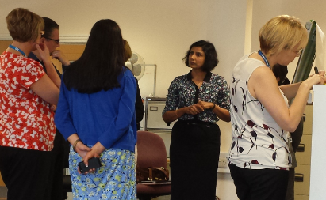
Then collectively we took note and; We Did
Co-design a model of care
In partnership
EL CCG
Primary Care
Optometrists
ELHT
To develop
Integrated Eye Service
Working together
Designing the Best Service for Patients

Slide 5
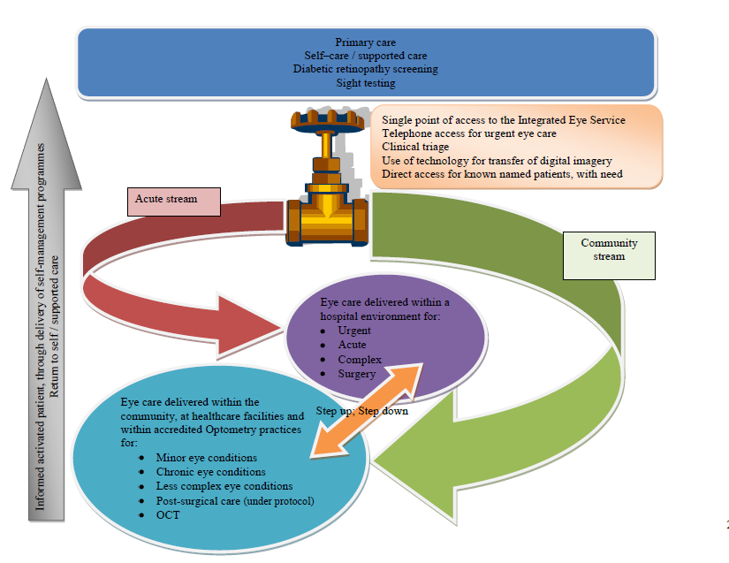
Integrated eye service; model of care

Slide 6
What will this integrated team deliver?
Urgent eye pathway
Ophthalmologists and Optometrists working together
Integrated referral hub (Single point of Access and timely triage)
Care closer to home
Integrated pathways – step up and down
Strong clinical leadership/managerial partnership
Deflection of activity from hospital to community
Education & support to primary care
Integrated information system
Direct referral by Optometrists to Ophthalmology
Good patient experience
Staff satisfaction
Sustainable model
HES
Enhanced optometry
Primary care
Supported care / self care

Slide 7
So what part does Primary care play?
Shared responsibility for the whole patient journey; supported by specialist practitioners
Working as part of an extended team
Quality referral into the integrated referral hub (SPoA) or urgent eye pathway
Access to learning to enhance quality of care & consistent practice
Working together for continuous improvement
HES
Enhanced optometry
Primary care
Supported care / self care

Slide 8
And what about our patients?
Informed activated patient
Involved and informed
Treated as a whole person
Supported by specialist & generalist practitioners
In receipt of consistent health messages and best care
Care when and where needed; Right person, Right time, Right place; First time, Each time
Care closer to home
Quality outcomes; enhancing quality of life
HES
Enhanced optometry
Primary care
Supported care / self care

Slide 9
Questions?

